Slide 1
At Rolling Arrays, we strive to spread happiness and transform HR processes through cutting-edge technology.
We been helping companies across industries to make the most of the SAP SuccessFactors ecosystem.
Our SuccessFactors Add-ons (Pre-integrated with SAP SF and supports single sign-on)
AI-Enabled Expense Management Solution for Enterprises
Allows you to track, access, and search all employee documents in one repository
Gives you the power to create custom learning content and capture tacit knowledge across your organization
Helps capture time easily and seamlessly for you and your employees
Some of our clients

Slide 2
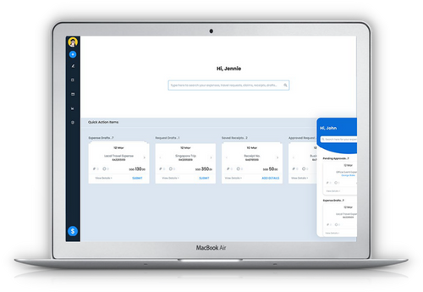
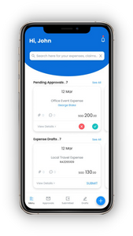
Mike is having a tough time sorting all his claims. The finance team isn't able to verify his tickets.
Mike needs Reimburse - an app that can help him manage travel claims easily.
AI-Enabled Expense Management Solution for Enterprises​
Pre-integrated with SAP SuccessFactors Employee Central (EC)​
Cloud Solution (SAAS) deployed on SAP Cloud Platform​
Single sign-on (SSO) with SAP SuccessFactors​
Dynamic ​Rule Engine​
Audit Trials
Dedicated Mobile App
OCR (Image/​Receipt Reader)​
Multi Country​ & Org Setup
Travel Advance
Duplicate Receipt Detection
Policy Inspector
Custom Approval Workflow
Travel Authorization & Requests​
Real-time Data & Reports​
Integrated with​ Finance Systems​
Some of our clients

Slide 3
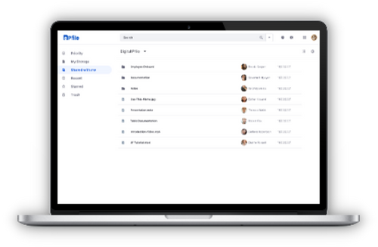
Beat the mess of managing employee documents
Eliminates paper-based records management​ and allows you to track, access, and search all​ employee records in one repository.
Take control of all employee documents with ePFile.​
Cloud Solution (SAAS) deployed on SAP Cloud Platform​
Single sign-on (SSO) with SAP SuccessFactors​
Document Storage​
Document Retrieval from SAP SuccessFactors​
ESS/MSS/HR Admin Service​
Mass Import​
Shared Workspace​
Templates - Document Creation​
Some of our clients

Slide 4
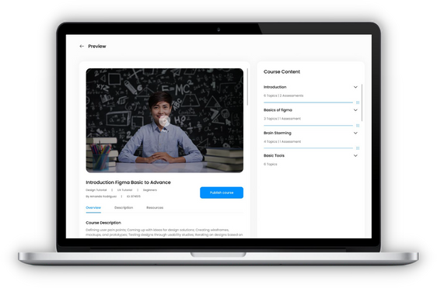
Enlighten your employees the way you want to.
Gives you the power to create custom learning content and capture tacit knowledge across your organization
Cloud Solution (SAAS) deployed on SAP Cloud Platform​
Single sign-on (SSO) with SAP SuccessFactors​
Simple interface​
Intuitive media​
Faster with​
templates​
Keep track of what’s​ happening​
Customize how you​
want to assess​
White label your​
courses​
Role-based access​
controls​
Esteemed Client

Slide 5
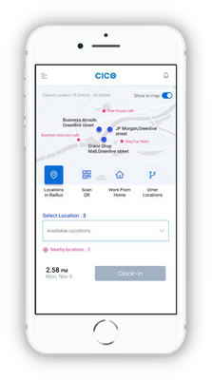
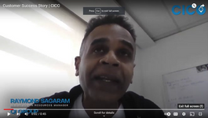
Get in and out of the office like bees get in and out of their hive — seamlessly.
Geo-fencing, Face & Finger Recognition enabled and Seamlessly Integrated with SAP SuccessFactors Employee Central (EC). ​
Cloud Solution (SaaS) deployed on SAP Cloud Platform​
Single sign-on (SSO) with SAP SuccessFactors​
Geo Fencing
Face Recognition
Finger Recognition
QR Code
Intelligent Alerts & Reports
Dynamic Rule Engine
Available for iOS & Android
Real-Time Insights
Dedicated Support
APIs to Integrate for Time Processing​
Works Offline​
(Supports no internet areas)​
Success Story
Some of our clients

