Slide 1
Course Creation Solution built for SAP Success Factors

Slide 2
BUSINESS PROBLEM
Many employees are not well-versed with the skillsets required for that particular job role before taking it on. This could potentially cost the organization a lot of time and tedious labour in training them.
THE ACTION
What can you do to ensure that your employees have the relevant skillsets while being their most efficient and productive selves?
2

Slide 3
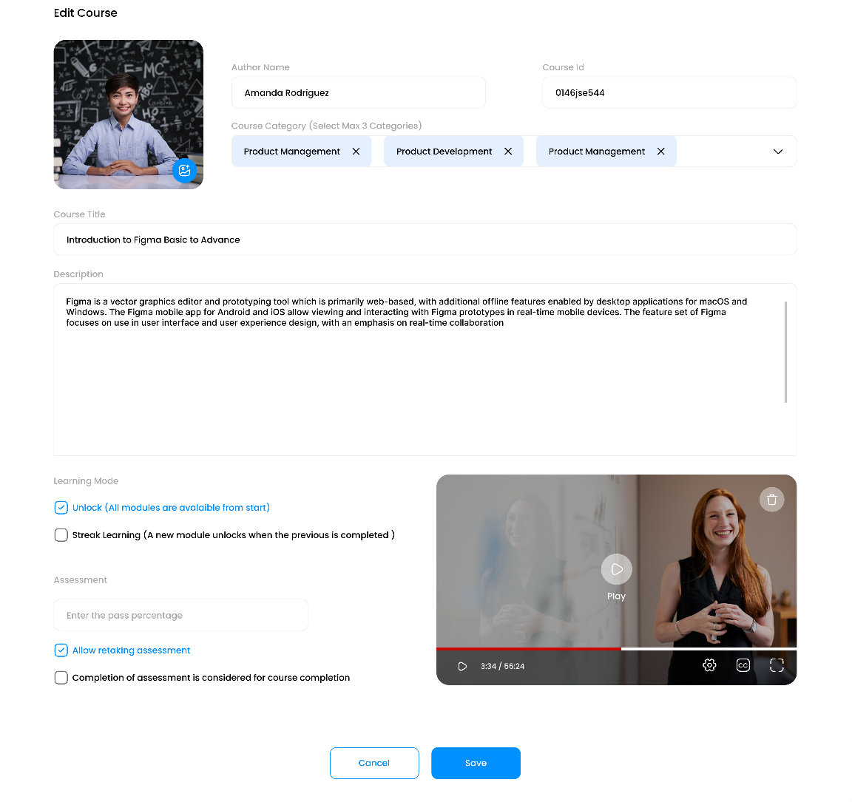
WHAT IS eAUTHORING?
eAuthoring is a robust and comprehensive learning management system designed for new-age learners. Our platform is simplified to enable users to create and publish courses without much complexity.
Effective online corporate training equips your employees with new skills they need to be more productive at work, and eAuthoring is your catalyst for this.
3

Slide 4
HOW eAUTHORING WORKS​
Three simple steps to self-authoring unique enterprise knowledge​
Step 1
Step 2
Step 3
Add Content​
Publish and manage​
Create Course
Design the course as per specific business and training needs from course category, details, segments and overall course flow.
Use various content formats from text, image, audio to video and add assessments
Publish the course and manage seamlessly from SAP SuccessFactors Learning module
4

Slide 5
FEATURES
Course Creation
Course Review
Course Consumption
Build content easily clone or copy a course for updates or as templates. Create in-course assessments to facilitate engagement with the course consumer.
eAuthoring facilitates peer review before publishing the course. Content creators can preview and test-run their create or /uploaded content in learner mode.
The system adopts different forms of media to create digital content for display. The system supports a responsive web design with automatic optimized viewing across various devices and platforms.
Integration
Course Analytics
3rd Party Training Form
Out-of-box seamless integration with the SuccessFactors LMS system, with a Single Sign On Support to integrate with any Organization Sign-on service.
In-built dashboard for the course creator enables course effective analysis.
The system can setup multi-level approval to streamline 3rd Party Training request workflows.
5

Slide 6
There’s always something new to learn on the job, and the eAuthoring tool is a great place to start!
Get in touch with us to know more.
eauthoring@rollingarrays.com

